Slide 1



SOFTWARE DEVELOPMENT PROFESSIONAL PROGRAM
Storing Data With Arrays

Slide 2





Storing Data With Arrays
Learning Objectives
Define an array.
Access an array element by its index.
Add an element to an array.

Slide 3

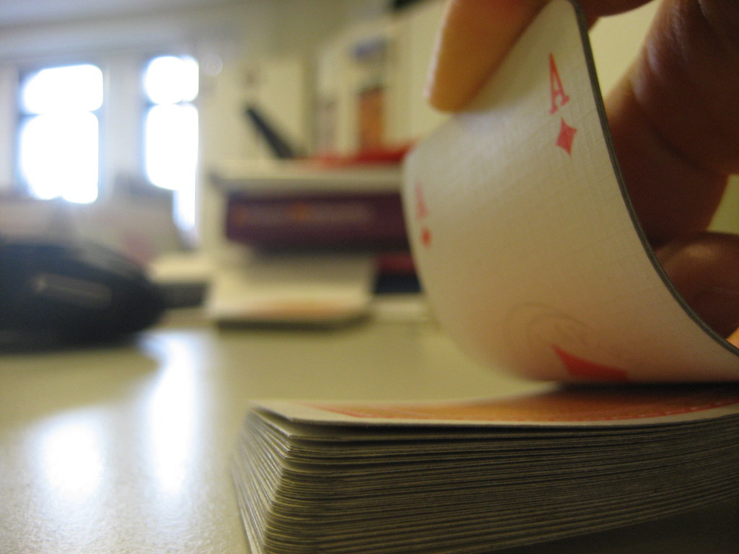
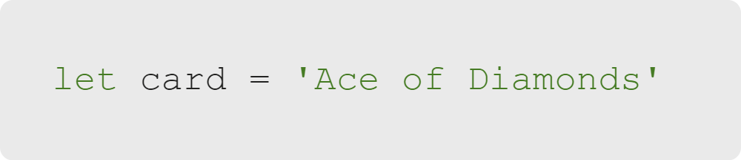
Storing Data With Arrays
Cards
Notes:
Imagine a deck of playing cards. In JavaScript, we could represent a single card as a string...

Slide 4

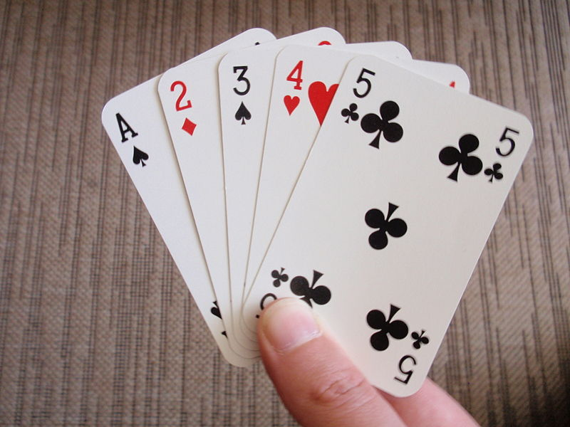
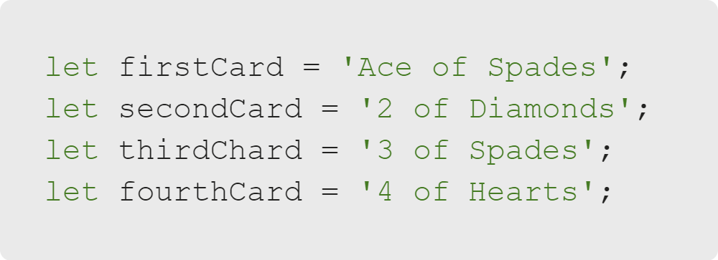
Storing Data With Arrays
Cards
Source: Wikimedia Commons
Notes:
But how could we represent a hand of cards?
We could create more variables... but there would be no way for us, or the computer,
to know that these variables are grouped together.

Slide 5
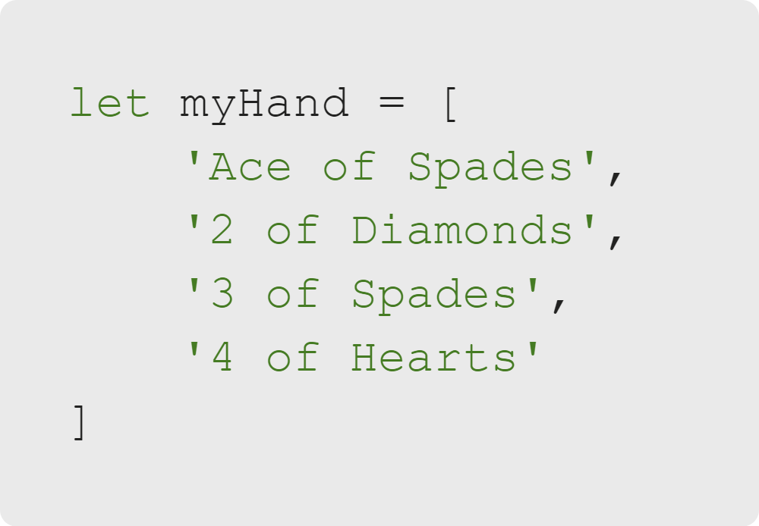
Storing Data With Arrays
Arrays
Source: Wikimedia Commons
Notes:
This is where arrays come into play. Arrays are another type of variable in the same way that strings and numbers are types of variables.
Arrays are a little different from the types of variables we've looked at so far because they *contain* other variables.

Slide 6


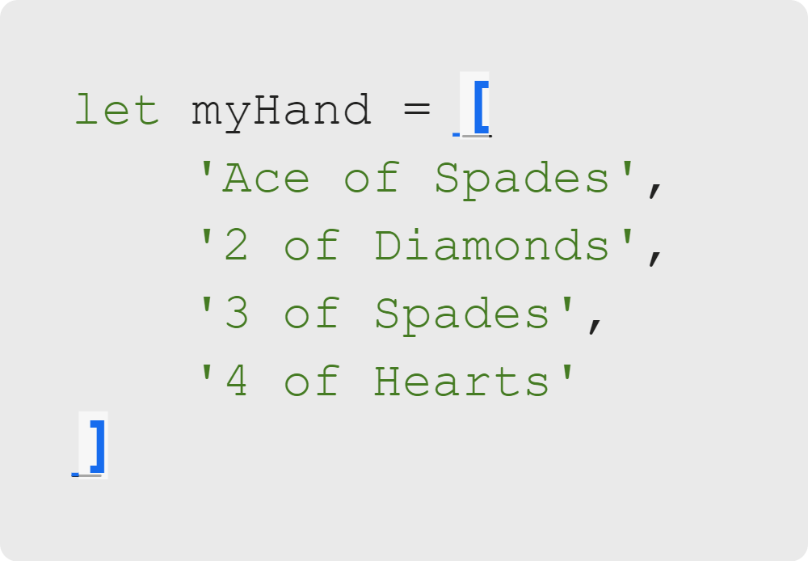
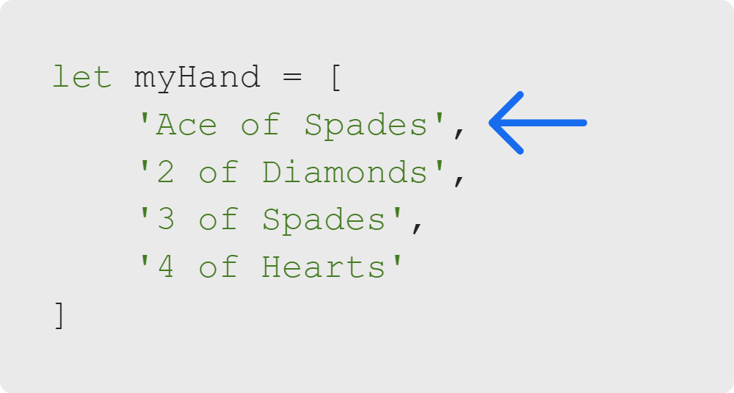
Storing Data With Arrays
Defining an Array
Define an Array using "[]"
Separate the variables contained in an array using ","
Notes:
We define an array the same way we define any other variable:
- key-word (var, let, or const)
- variableName
- assignment operator (equals sign '=')
- value
Like the quotation marks to define a string, we use square brackets to define an array.
Since an array can store many values, we use commas to separate items in the array
<<Exercise 01--define an array with three values of differing types>>
<<Exercise 02--define an array that contain three different strings>>

Slide 7
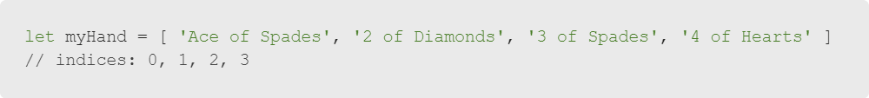
Storing Data With Arrays
Array Indices
Notes:
JavaScript will track the position of each element in the array, starting at 0.
We refer to this position as the "index" of an element in the array.
<< Remind learners that the word "indices" is the plural of "index" for clarity.>>

Slide 8
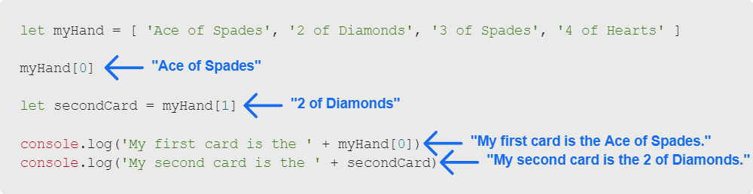
Storing Data With Arrays
Accessing Array Elements by Index
Notes:
We can use the index of an element to access its value in an array.
<<Exercise 03--store the value of an array item in a separate variable>>

Slide 9

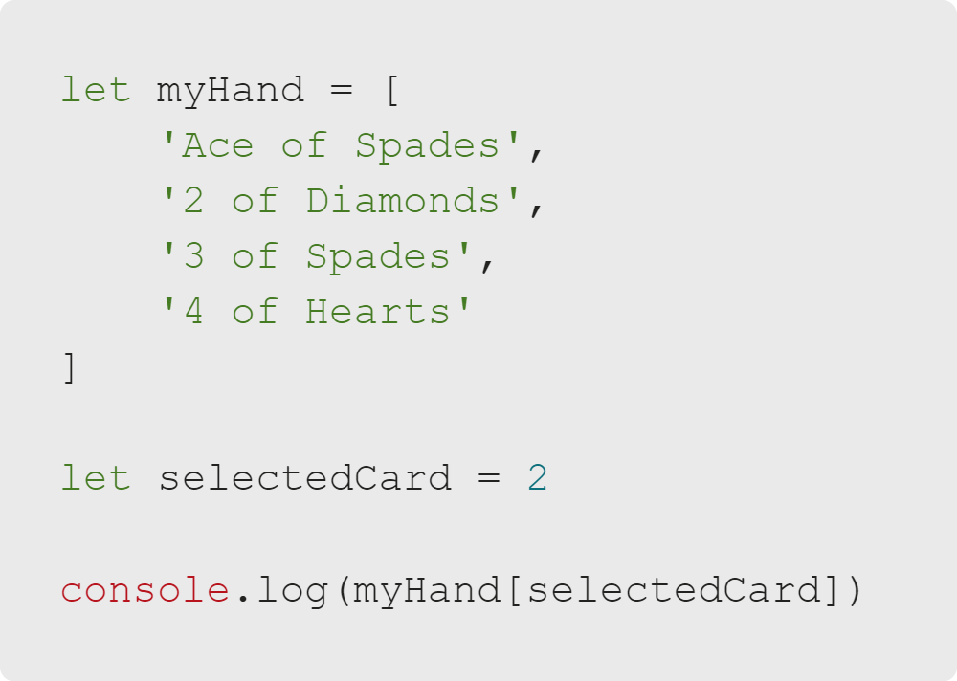
Storing Data With Arrays
Quiz: Multiple Choice
What will be logged?
A. 3 of Spades
B. 2 of Diamonds
C. Nothing
D. An error

Slide 10
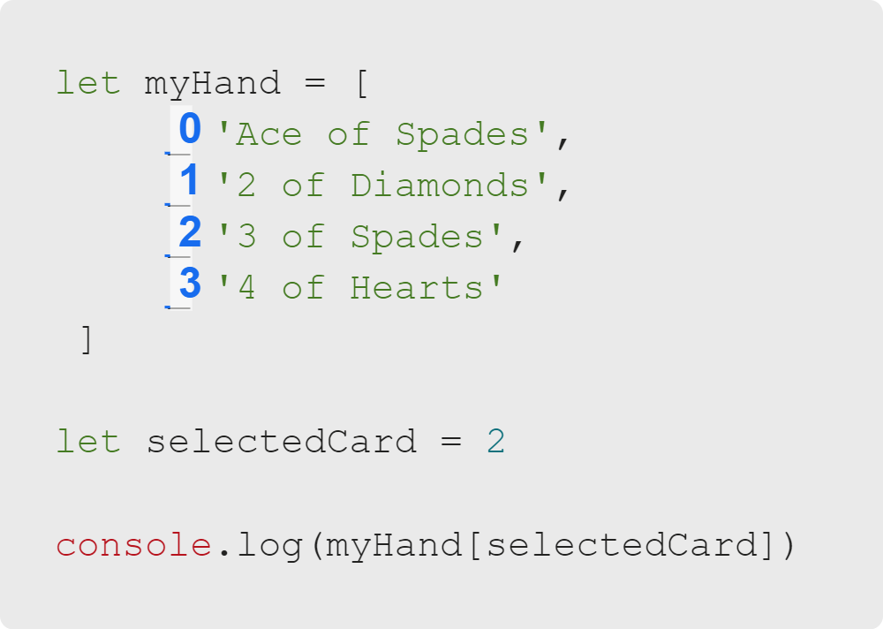
Storing Data With Arrays
Quiz: Multiple Choice Answers
What will be logged?
✅ 3 of Spades
🚫 2 of Diamonds
🚫 Nothing
🚫 An error

Slide 11
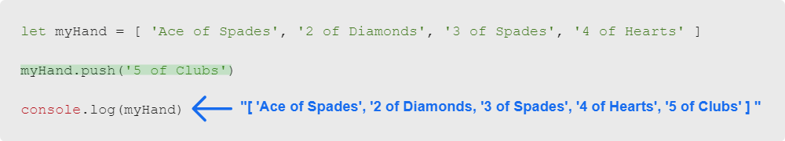
Storing Data With Arrays
Adding Elements to an Array
Notes:
We can use .push to add an element to the end of an array.

Slide 12
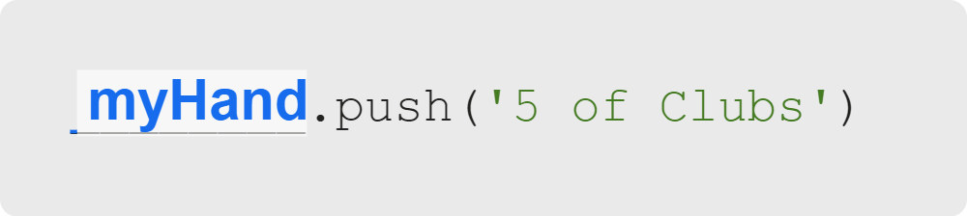
Storing Data With Arrays
Calling .push
Call .push on (right after) an array variable.
Put whatever you want to add to the array in parentheses after .push.
Notes:
<<Exercise 04--add an element to an array>>

Slide 13
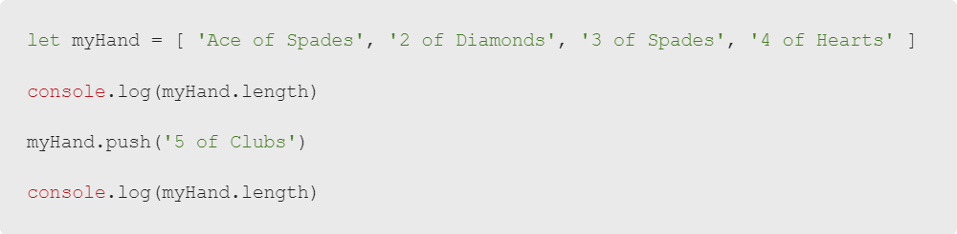
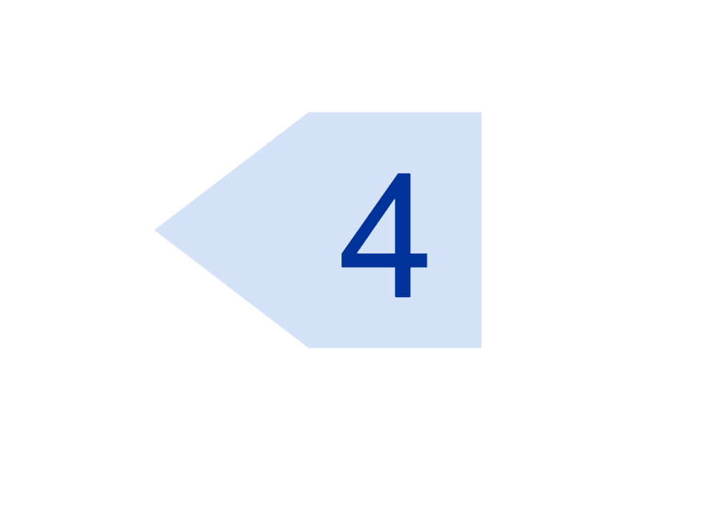
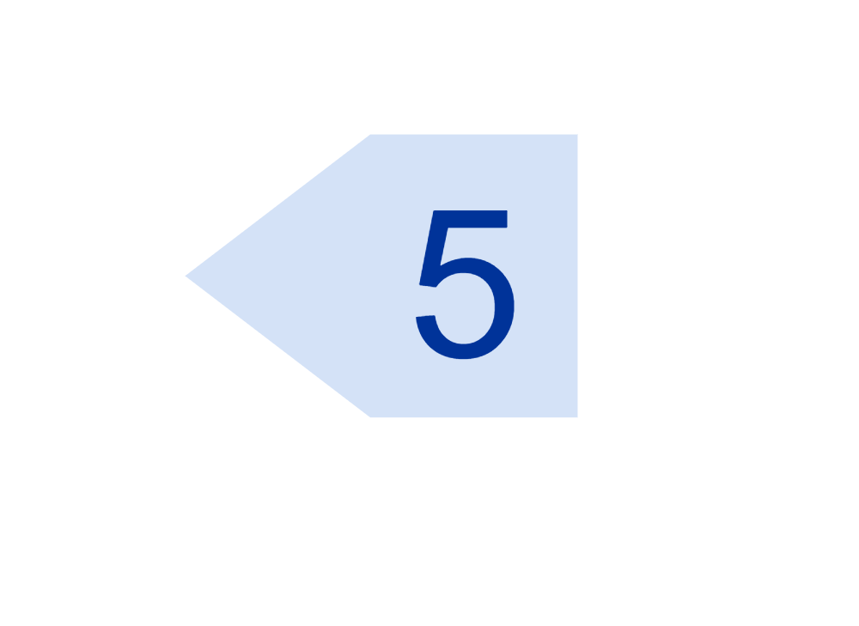
Storing Data With Arrays
Using .length
Notes:
We can call .length on an array to get the number of elements in an array.
<<Exercise 05--what does .length return?>>

Slide 14
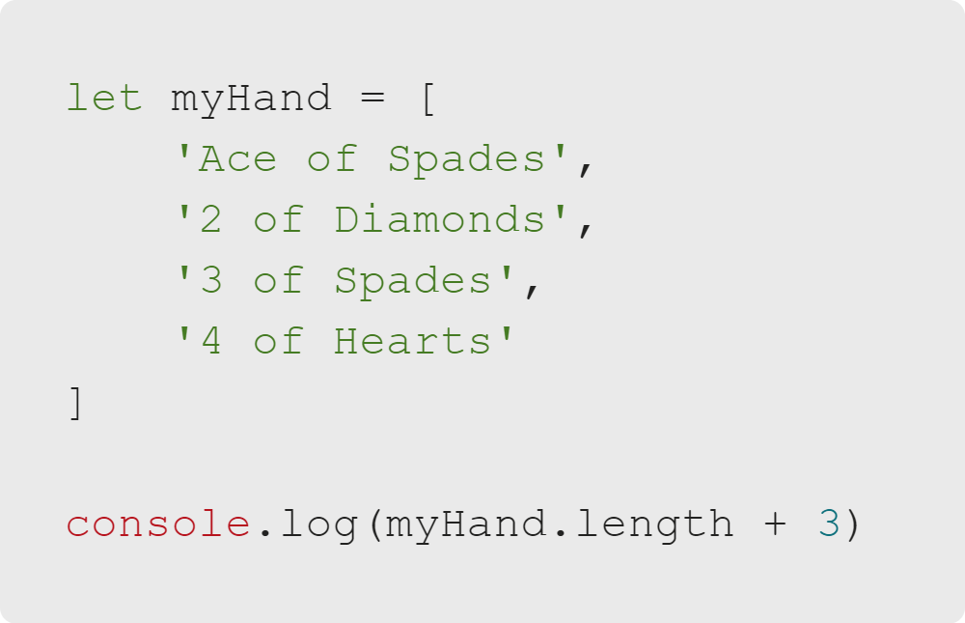
Storing Data With Arrays
Quiz: Multiple Choice
What will be logged?
A. An error
B. 6
C. 7
D. 43

Slide 15
Storing Data With Arrays
Quiz: Multiple Choice Answers
What will be logged?
🚫 An error
🚫 6
✅ 7
🚫 43
Notes:
<<If a learner guesses '43', you can explain the difference between concatenating two strings vs adding two numbers.
Because array.length returns a number and 3 is also a number, JS adds them together>>

Slide 16
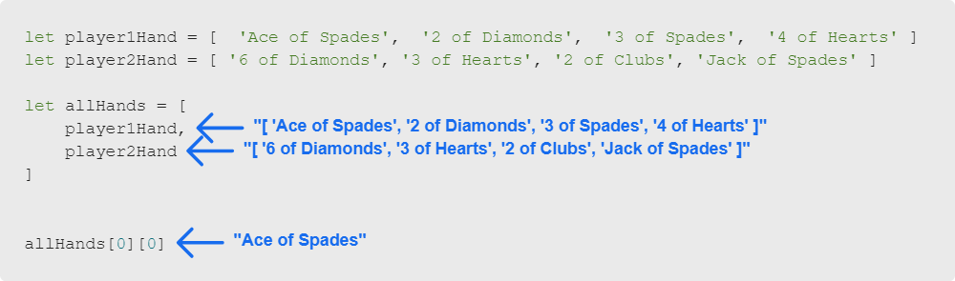
Storing Data With Arrays
Nested Arrays
A nested array is simply an array of arrays.
Notes:
So far, we've looked at arrays of strings and arrays of numbers.
But arrays can contain anything, even other arrays!
Nested arrays are also referred to as multidimensional arrays or matrices.

Slide 17
Storing Data With Arrays
Summary
What We've Covered:
Storing Data With Arrays
Defining Arrays
Array Indices
Accessing Array Elements
Adding Array Elements
Using .length
Nested Arrays
Let's practice working with nested arrays.

